Slide 1
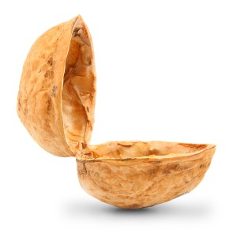
Damage in Metal Forming
A brief introduction

Slide 2
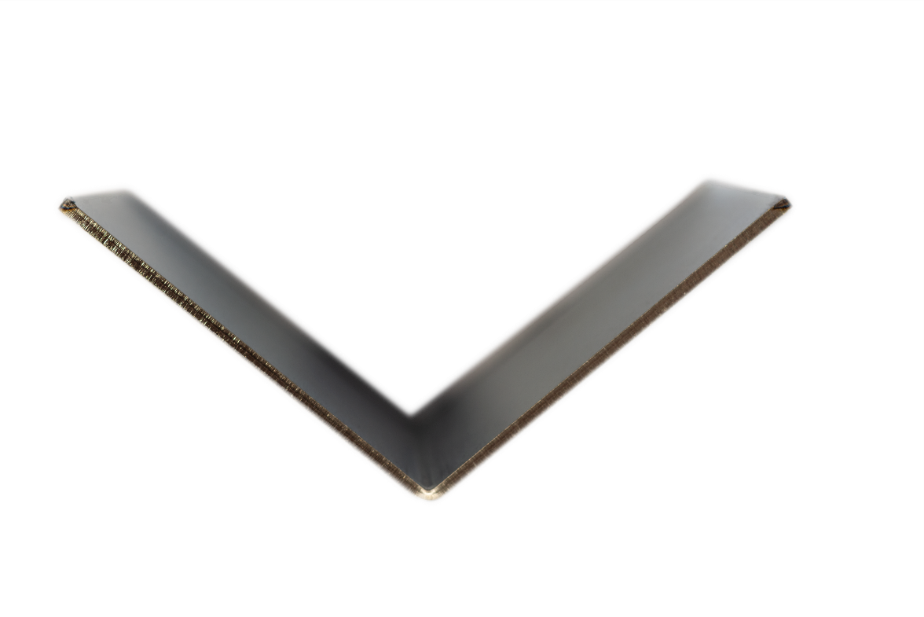
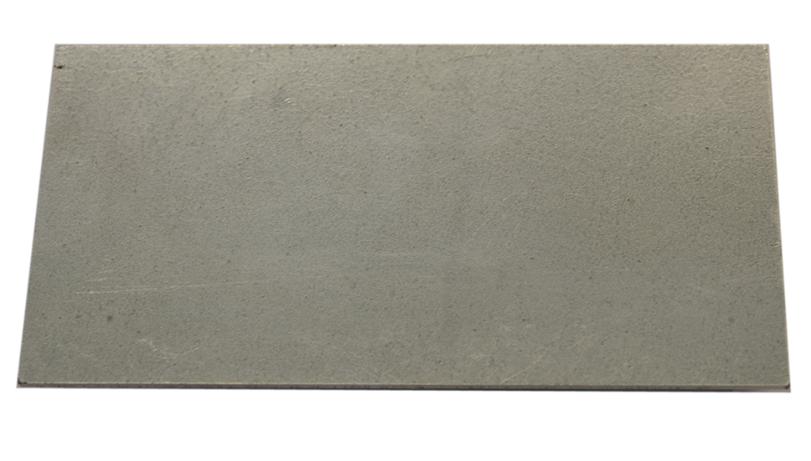
Time to change the length scale
Original State
Air Bending
OK
macroscopic
$b_{0}$ = 50 mm
t = 1.5 mm
DP800
$r_{m}$ = 1.2
${\overline{ε}}_{t,}$_{max} = 0.41
${σ_{y}}_{0}$ = 494 MPa
$l_{0}$ = 100 mm
?
$$\overline{ε_{t}}=\frac{2}{\sqrt{3}}\ln\left(1+\frac{t}{2r_{m}}\right)$$
?
!
< 85 000 voids
→ ~ 11 voids/mm³
~ 27,500,000 voids
~ 390 000 voids/mm³
in the forming zone
microscopic
35,000x

Slide 3
Visualization of forming-induced Damage
Void growth during bending
Sheet
Punch
Material: DP800
Die
100 µm (magnification: 200x)
Dunlap et al., GFE, RWTH Aachen

Slide 4
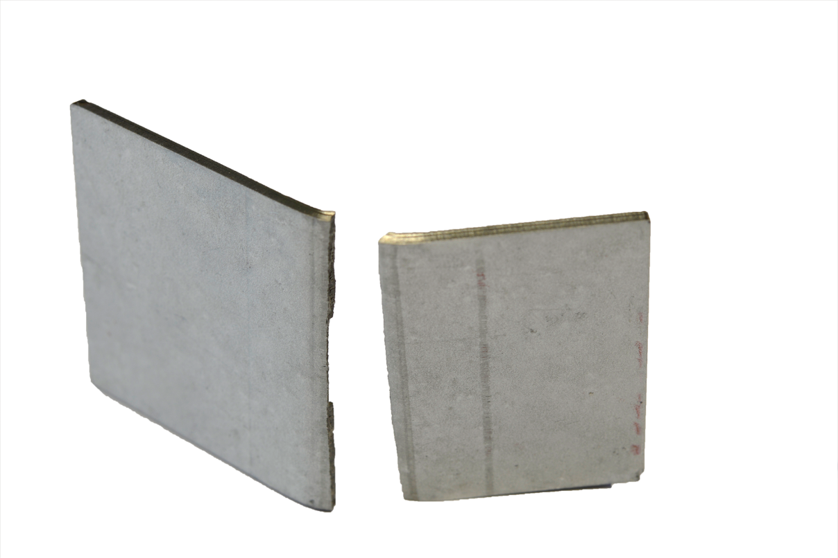
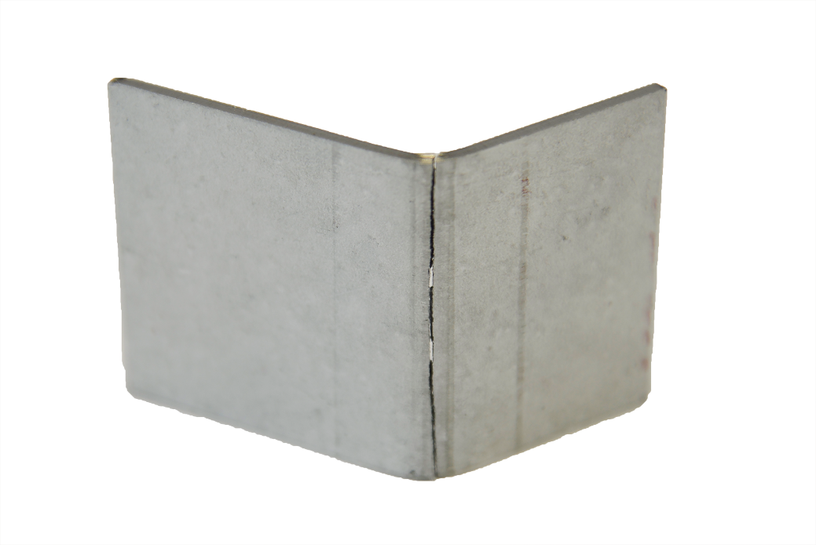
Failure vs. Damage
What is failure?
Failed part
Cracks, failure
10 µm
Material: DP 800

Slide 5
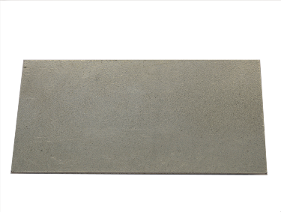
Failure vs. Damage
Load during plastic deformation
What is damage?
What is failure?
Inhomogeneity
Void
?
Coalescence
Good part
Tensile Load
Failed part
Damage is not a failure.
Source: Reusch (2003)
Initial material
Nucleation and growth of voids
Coalescence of voids
Cracks, failure
Material: DP 800
10 µm
5 µm
Kusche et al., IMM, RWTH Aachen
Material: DP 800

Slide 6
What is Damage?
Process
Damage
Property
Duality

Slide 7
What is Damage? – It‘s a Process
Load during plastic deformation
Process
Damage
Property
5µm
Material: DP 800
Kusche et al., IMM
Damage Evolution encompasses the nucleation, growth and coalescence of voids.
CT-Scan showing voids
Khazis (2015)

Slide 8
What is Damage? – It‘s a Property
$$σ$$
Process
Damage
Property
undamaged
The Damage Value describes the influence of the product performance.
damaged
$$ε$$
As a property, damage links the measurable damage values with the degradation of the product performance.

Slide 9
Conventional Product Development Cycle
Material properties
Function
Design
Component geometry
Forming process
Component with unknown safety margin
Load
Strain hardening
✓
Residual stresses
✓
Damage
X

Slide 10
Improving the Product Development Cycle
Damage
Prediction of performance
Material properties
Product properties
Function
Component with known safety margin / improved product performance
Design
Component geometry
Damage controlled manufacturing
Casting
Forming
Heat treatment
…
Load
Strain hardening
✓
Residual stresses
✓
Damage
X
Strain hardening
✓
Residual stresses
✓
Damage
✓

Slide 11
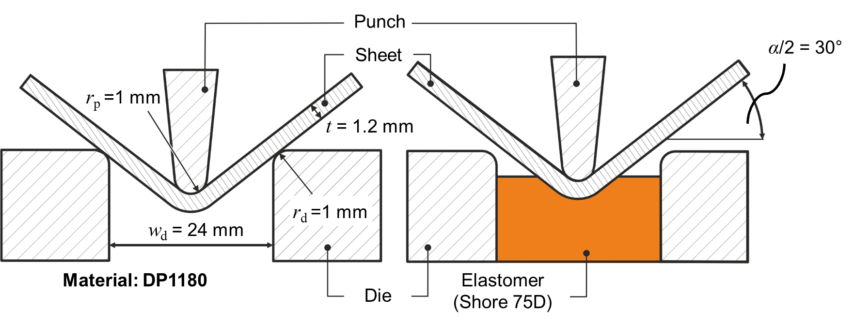
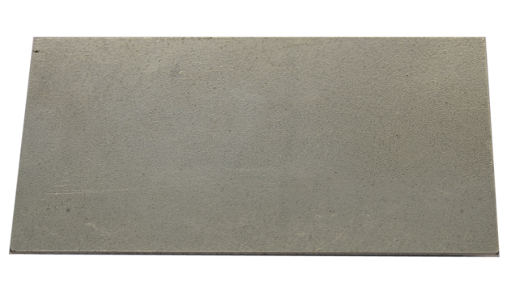
Controlling Damage in Bending
Damage Controlled Bending Process
Original State
< 85 000 voids
→ ~ 11 voids/mm³
Air Bending
t = 1,5 mm
$b_{0}$ = 50 mm
t = 1.5 mm
$l_{0}$ = 100 mm
DP800
${\overline{ε}}_{t,}$_{max} = 0.41
${σ_{y}}_{0}$ = 494 MPa
Damage is controlled via additional counter-pressure on the outside.

Slide 12
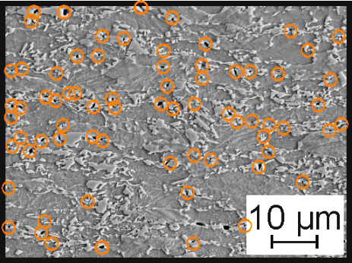
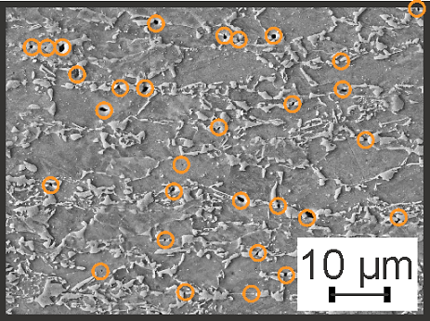
Controlling Damage in Bending
Damage Controlled Bending Process
Original State
< 85 000 voids
→ ~ 11 voids/mm³
Air Bending
~ 27,500,000 voids
~ 390 000 voids/mm³
in the forming zone
~ 15,100,000 voids
→ ~ 210 000 voids/mm³
in the forming zone
- 45 %
$b_{0}$ = 50 mm
t = 1.5 mm
$l_{0}$ = 100 mm
DP800
${\overline{ε}}_{t,}$_{max} = 0.41
${σ_{y}}_{0}$ = 494 MPa
Notes:
Qualitative analysis

Slide 13
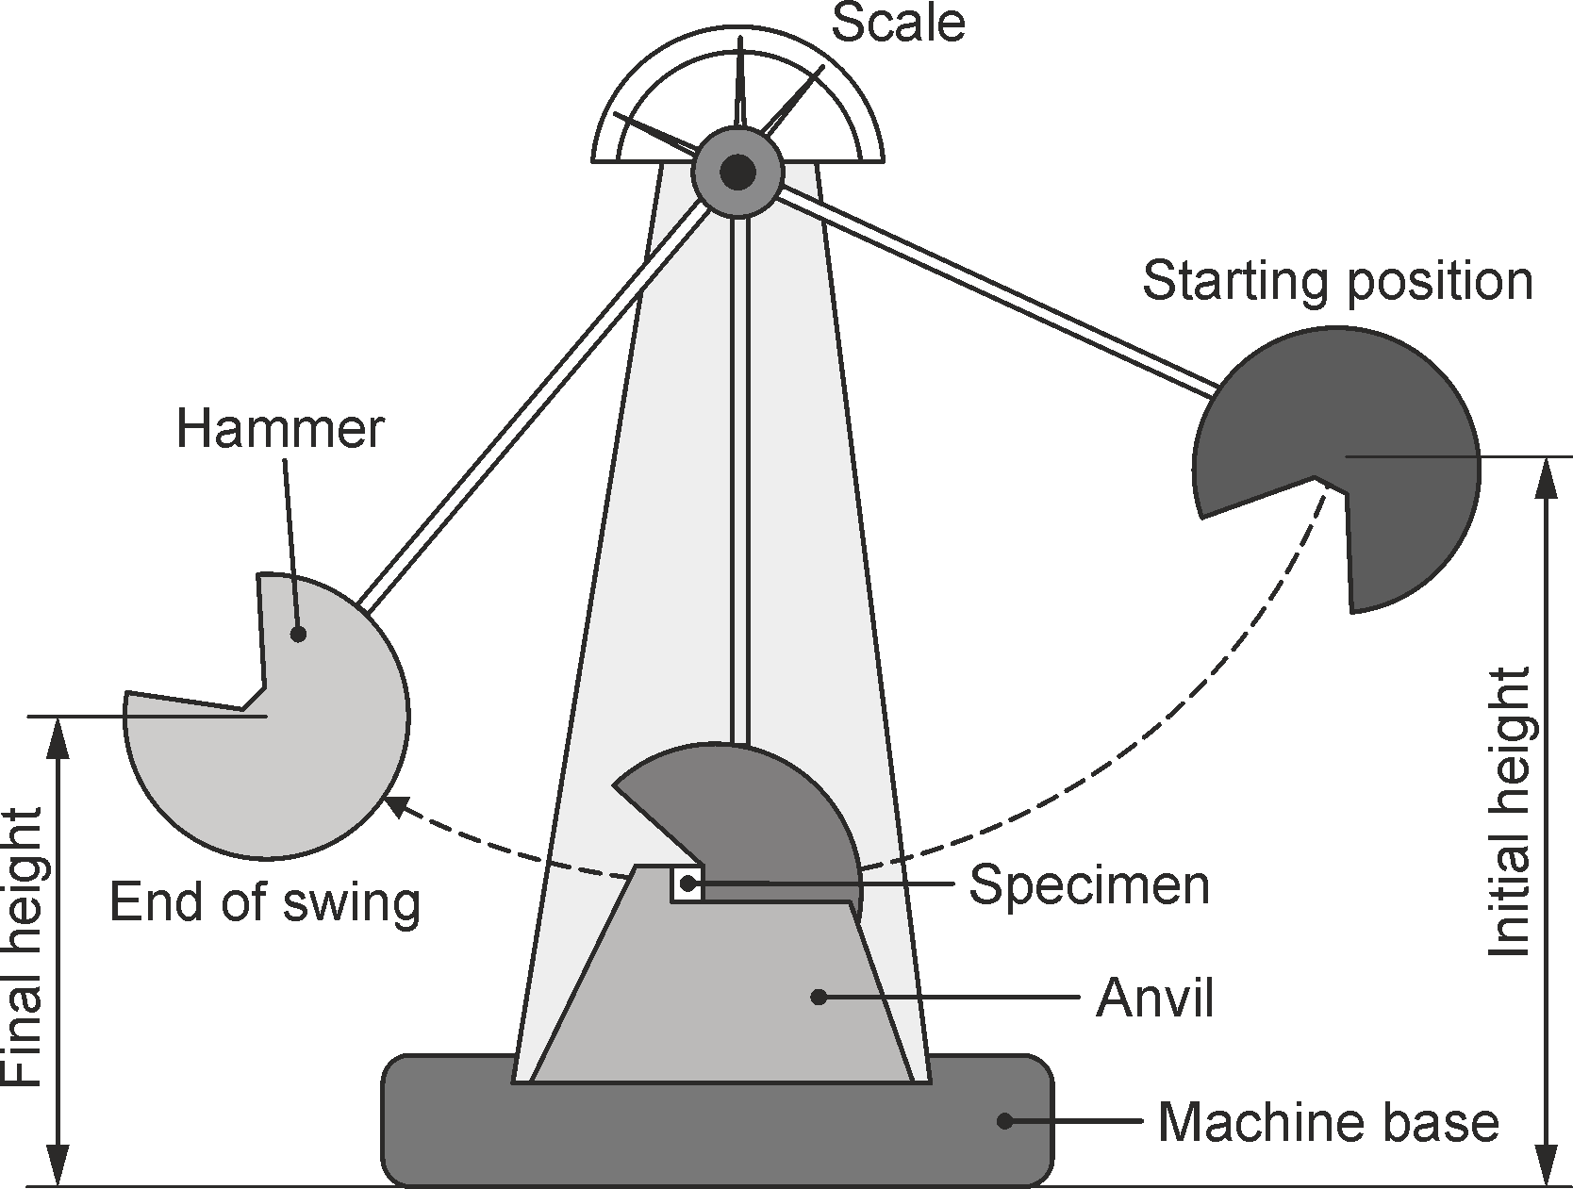
Increasing the Product Performance
Impact performance evaluation

Slide 14
Increasing the Product Performance
Impact performance evaluation
+ 19% in performance
achieved
enables
Improved safety margin
Reduction of sheet thickness
reduced damage value
Notes:
Quantitative analysis

Slide 15
Summary on Damage
Damage is not a failure!
Damage is a process and a property.
Damage control in metal forming is possible.
Damage influences the product properties and performance.
?
What is the dependency on plastic deformation
How can damage be characterized
How can damage be modeled
Notes:
Verweis auf 30 / 90min Versionen, da noch viele offene Fragen, insbesondere Begriffsdefinitionen etc.

Slide 16
Vielen Dank für Ihre Aufmerksamkeit. Thank you for your attention.

